Slide 1
BMI508 – Fall 2025
Introduction to Biomedical Ontology
Class 5 – Sept 24, 2025
General principles for realism-based ontology development
Werner CEUSTERS^{1,2}
¹ Department of Biomedical Informatics, University at Buffalo, USA
² Department of Psychiatry, University at Buffalo, USA

Slide 2
Last week’s extra credit opportunity: correct the axioms so that 2 distinct processes can occupy the same STR.
If a process is part of another, their spatiotemporal regions are part too:
(forall (p1 p2)
(if (and (exists (t) (instance-of p1 process t)) (exists (t) (instance-of p2 process t)))
(iff (occurrent-part-of p1 p2)
(exists (st1 st2)
(and (occupies-spatiotemporal-region p1 st1) (occupies-spatiotemporal-region p2 st2) (occurrent-part-of st1 st2))))))
Occurrent-part-of is antisymmetric:
(forall x y) (if (and (occurrent-part-of x y)
(occurrent-part-of y x))
(= x y)))

Slide 3
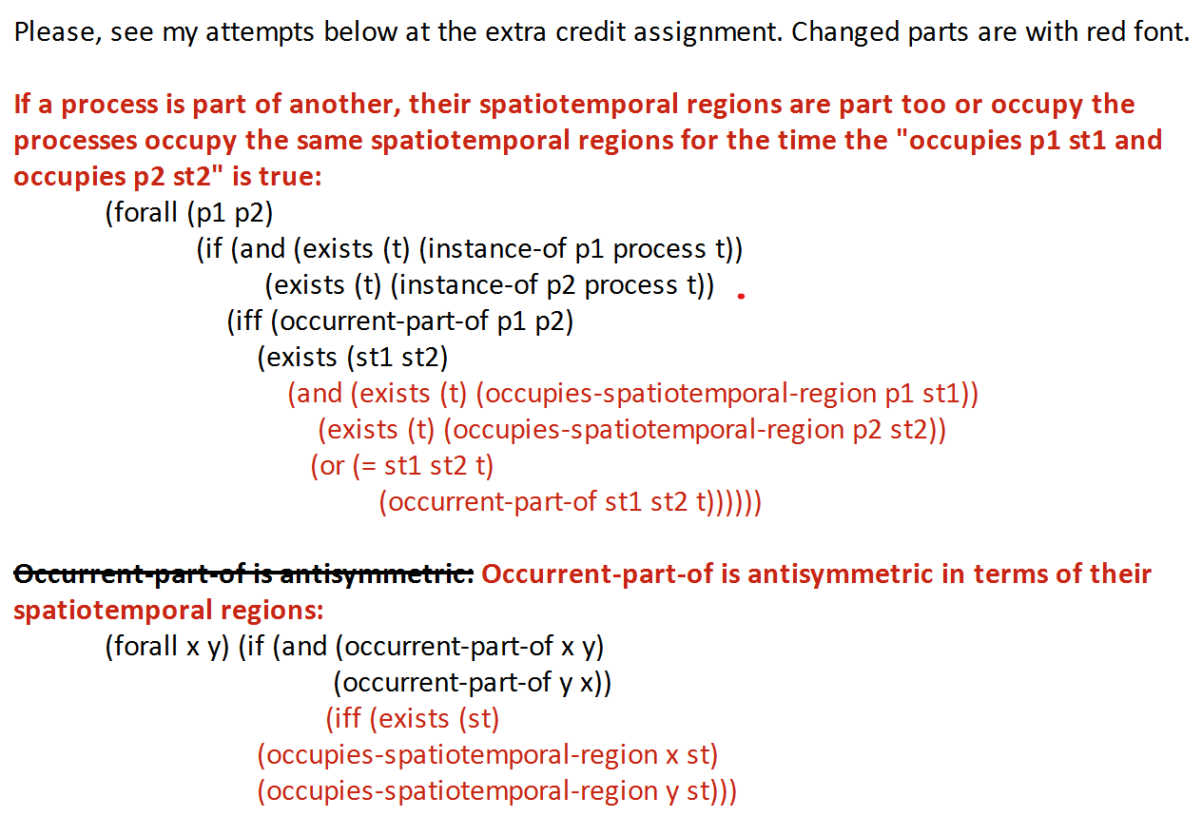
A student’s response

Slide 4
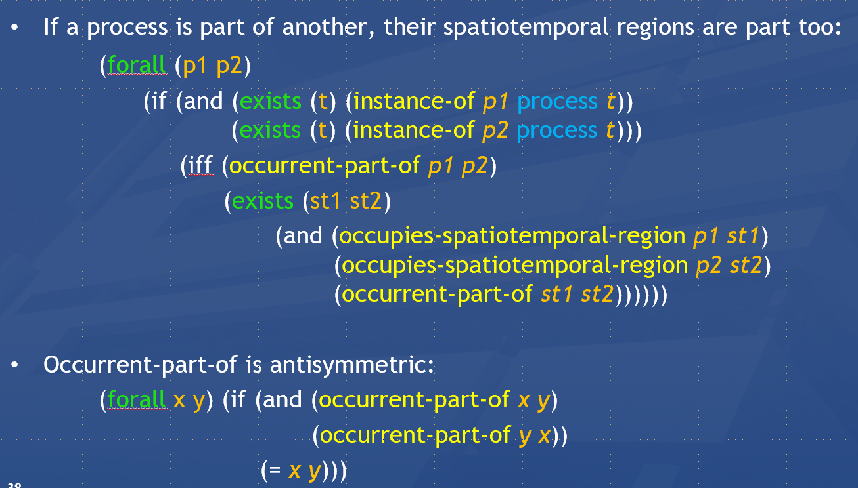
Last week’s extra credit opportunity: correct the axioms so that 2 distinct processes can occupy the same STR.
The mistake in the original axiom is the use of the biconditional (iff) between “process part-of” and “region part-of.” Written this way, it incorrectly claims that two processes are part of each other if and only if their spatiotemporal regions are part of each other. This is wrong because multiple distinct processes can share the same region without being parts of one another. As observed in the example, a ball spinning and a ball heating up both occur in the same spatiotemporal region, but spinning is not part of heating.
A student’s response

Slide 5
Reading pre-class
R9 Principles of best practice I and II. (pages 43-84) in: Arp, R., B. Smith, and A.D. Spear, Building ontologies with basic formal ontology. 2015, The MIT Press,: Cambridge, Massachusetts. p. 1 online resource (245 p.) [1]
UB login: https://ebookcentral-proquest-com.gate.lib.buffalo.edu/lib/buffalo/detail.action?docID=3433795&pq-origsite=primo

Slide 6
Required reading for next week
R5: The ontology of relations. (pages 131-150) in: Arp, R., B. Smith, and A.D. Spear, Building ontologies with basic formal ontology. 2015, The MIT Press,: Cambridge, Massachusetts. p. 1 online resource (245 p.)
UB login: https://ebookcentral-proquest-com.gate.lib.buffalo.edu/lib/buffalo/detail.action?docID=3433795&pq-origsite=primo

Slide 7
Assignment
A4: Apply the principles for term selection, replacement, formatting and definitions, discussed in class and in R9 to all the terms in your ontology so as to create version 2 (but keep version 1 as well as all later versions. You will need them for a much later assignment!)
Upload your work in a Excel doc (as for A3) to the UB Box assignment folder.
Detailed document layout: see demo at end of class.
Name of the file: ‘BMI508-A4-[your name].xlsx’.
Note: Keep the numbering of the assignment as indicated here in the syllabus.
Due date: September 29 – noon.

Slide 8
Class overview
General re-introduction of ‘ontology’ versus ‘terminology’
Terminology selection and management
Definitions
Ontology design / putting it together:
  lessons learned from A3
  How to transform A3 into A4 (demo)
8

Slide 9
Ontology ←→ Terminology

Slide 10
OASAS data checking instructions
[CHILDREN_LIVING_WITH_CLIENT] must be a whole number between 0 and 9
If [PRIMARY_SUBSTANCE_CODE] is 0 (none), then [PRIMARY_AGE_OF_FIRST_USE] must be space filled.
[PRIMARY_AGE_OF_FIRST_USE] cannot be greater than the age at admission.
[PREGNANT]
  [PREGNANT] must be either 1 (Yes) or 2 (No).
  If [SEX] is 1 (Male), [PREGNANT] cannot be 1 (Yes).
https://apps.oasas.ny.gov/portal/page/portal/OASAS_APPS/CDS_Public_Documentation/TAB38646/Tab/CDS_Batch_Transaction_File_Specification_0.pdf
10

Slide 11
Two important science- and research- related disciplines
Ontology
Terminology

Slide 12

Two important science- and research- related disciplines
Ontology
What entities exist?
How do entities relate to each other?
Terminology
What entities, if any at all, are denoted by words or terms?
How do terms relate to each other?
How to form declarative terms?
‘Earth’ ‘Aarde’ ‘La Terre’
Reality first
Representation first

Slide 13
Canonical case: faithful representation
Reality
Representation
‘Earth’
‘Aarde’
‘La Terre’
…
denotes
means
represents

Slide 14
Delusions, fantasies, imaginations, …
Reality
Representation
‘unicorn’

Slide 15
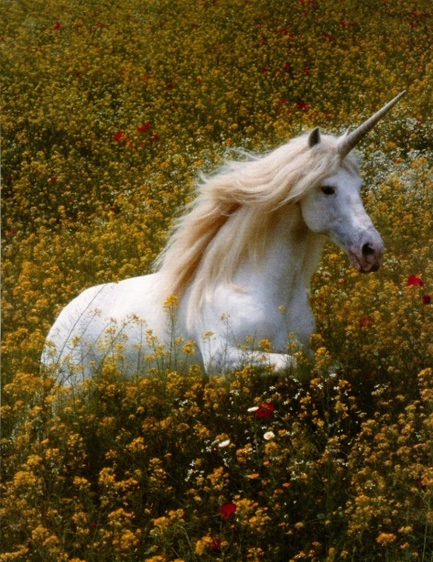
Delusions, fantasies, imaginations, …
Reality
Representation
‘unicorn’

Slide 16

Delusions, fantasies, imaginations, …
Terminology
Reality
Representation
‘unicorn’
Graphics

Slide 17
Delusions, fantasies, imaginations, …
Conceptualism
Terminology
Reality or
Imagination
Representation
‘unicorn’
Graphics
unicorn concept

Slide 18
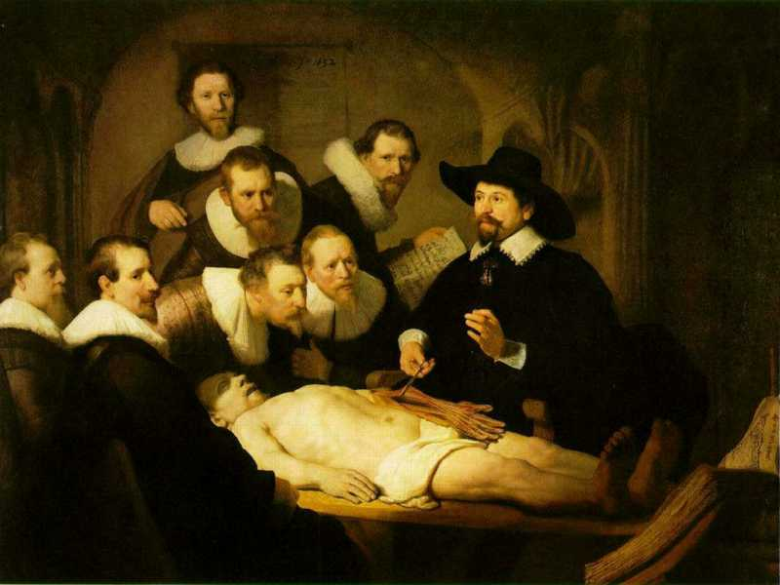
Three levels of reality
L1: what is the case
ontos
L2: what we believe
thought
logos
word / speech
L3: what we
communicate
Rembrandt van Rijn, The Anatomy Lesson of Dr. Nicolaes Tulp, 1632. Oil on canvas, 169.5cm x 216.5cm (Mauritshuis, The Hague)
Notes:
https://www.thewoventalepress.net/2018/02/12/an-anatomy-lesson/

Slide 19
Semiotic / semantic triangle
(Ogden & Richards, 1923:
The meaning of ‘meaning’)
concept
term
referent

Slide 20
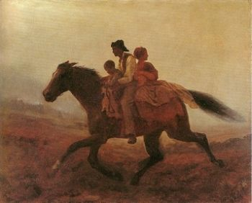
Prehistoric ‘psychiatry’: drapetomania
disease which causes slaves to suffer from an unexplainable propensity to run away
…
concept
term
referent
painting by Eastman Johnson. A Ride for Liberty: The Fugitive Slaves. 1860.
‘drapetomania’

Slide 21
Exercise: what may be the case in reality?
Reality
Representation
‘disorder’
‘disease’
‘illness’
‘sickness’

Slide 22
Exercise: what may be the case in reality?
Reality
Representation
‘disorder’
‘disease’
‘illness’
‘sickness’
U1
Synonymous-with

Slide 23
Exercise: what may be the case in reality?
Reality
Representation
U1
‘disorder’
‘disease’
‘illness’
‘sickness’
U2

Slide 24
Exercise: what may be the case in reality?
Reality
Representation
U1
‘disorder’
‘disease’
‘illness’
‘sickness’
U2
U3
U4

Slide 25
Exercise: what may be the case in reality?
Reality
Representation
U1
‘disorder’
‘disease’
‘illness’
‘sickness’
U2
U3
U4

Slide 26
How can we find out?

Slide 27
Term types
Natural language terms:
  Terms used in everyday language;
    → dictionaries
Technical terms:
  Terms used in technical language;
    → domain specific dictionaries
Type-terms:
  Terms used in ‘knowledge representations’:
    Denoting ‘concepts’ in (formal terminologies);
    Referring to universals (or defined classes) in realism-based ontologies → type-terms

Slide 28

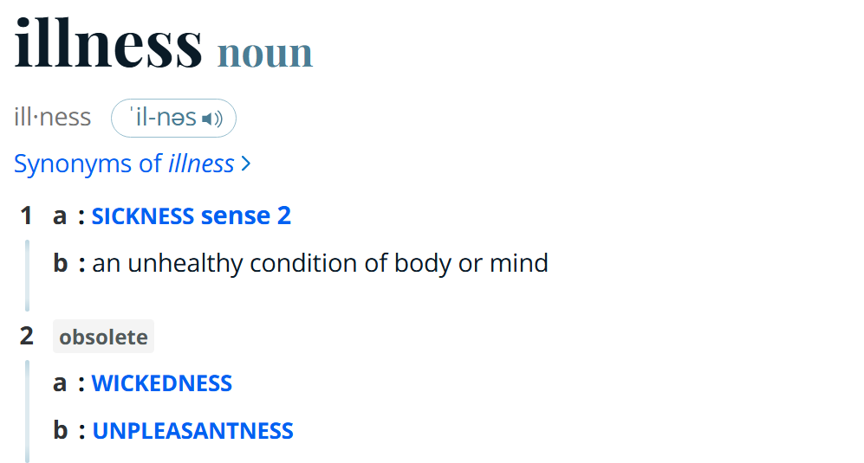
‘Illness’ in Merriam-Webster
https://www.merriam-webster.com/

Slide 29
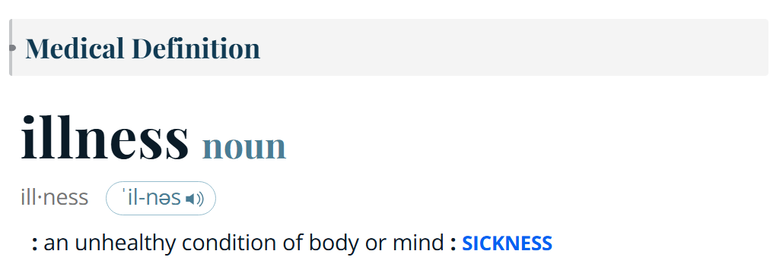
‘Illness’ in Merriam-Webster
https://www.merriam-webster.com/

Slide 30
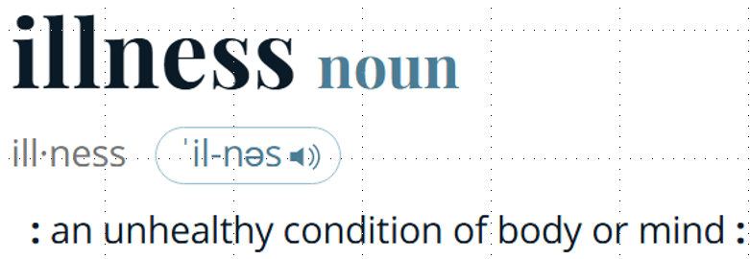
What is the case ?
Reality
Representation
‘illness’
illness

Slide 31
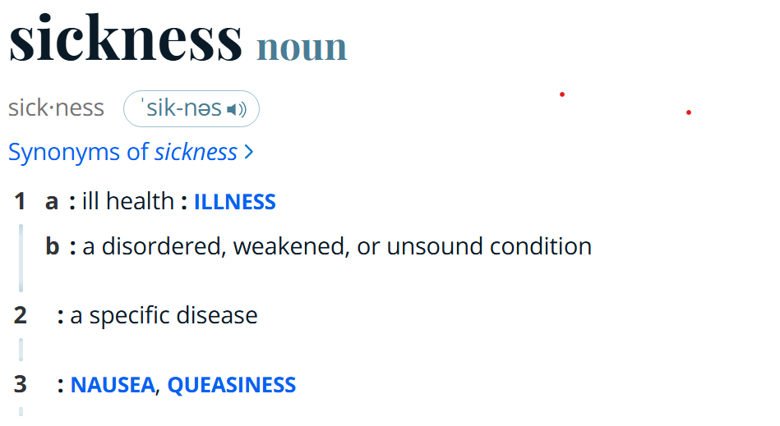
‘Illness’ in Merriam-Webster
https://www.merriam-webster.com/

Slide 32
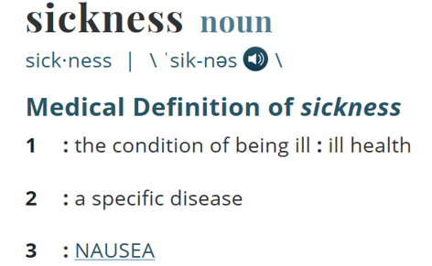
What is the case ?
Reality
Representation
‘illness’
Specific disease
=?
Homonymy
nausea
‘sickness’
illness
Synonyms?

Slide 33
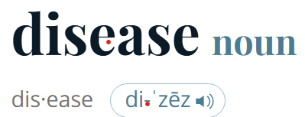
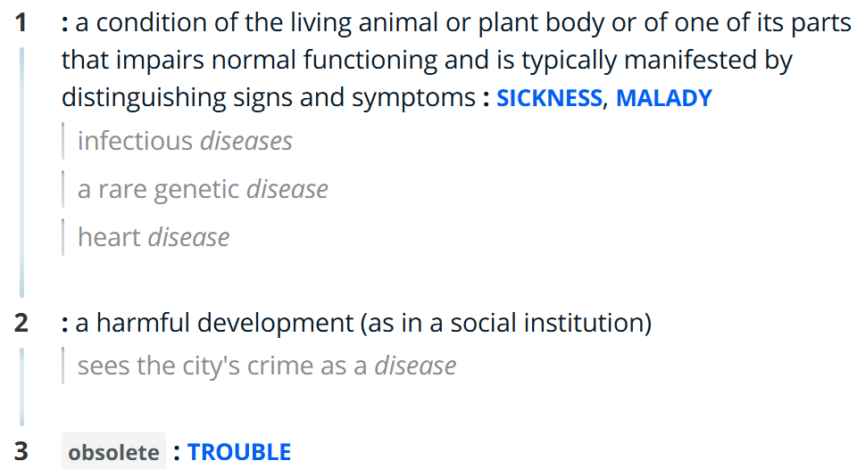
‘Illness’ in Merriam-Webster
https://www.merriam-webster.com/

Slide 34
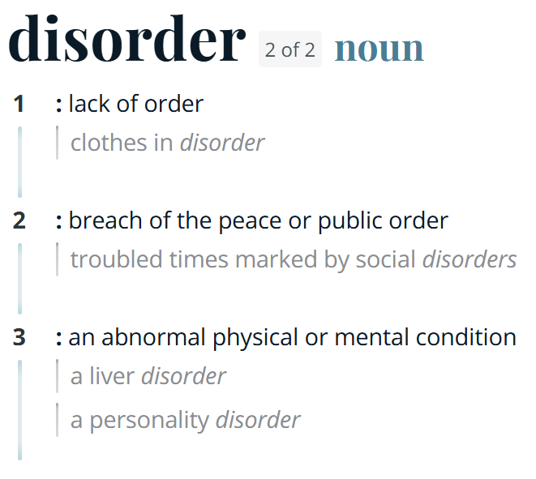
‘Illness’ in Merriam-Webster
https://www.merriam-webster.com/

Slide 35
Better general strategy
(than consulting dictionaries)
Use terminology and metaphysics:
To make decisions on what entities to represent in the ontology,
To define type-terms for these entities precisely,
…

Slide 36
Metaphysical inquiry as a start
Define terms precisely so that what is intended by (ideally) all uses of the corresponding terms in the language under scrutiny falls under it;
Investigate how what is intended by these uses relate to each other.
Example: the ‘Bio-Psycho-Social Perspective’ on disease

Slide 37
The objective Bio-Psycho-Social perspective
‘T_{o}-Disease’:
  a health problem that consists of a physiological malfunction that results in an actual or potential reduction in physical capacities and/or a reduced life expectancy
‘T_{o}-Illness’:
  a subjectively interpreted undesirable state of health, consisting of subjective feeling states (e.g., pain, weakness), perceptions of the adequacy of their bodily functioning, and/or feelings of competence
‘T_{o}-Sickness’:
  a social entity in virtue of the poor health or the health problem(s) of an individual defined by others with reference to the social activity of that individual
Twaddle, A. (1994a). Disease, illness and sickness revisited.
In: A. Twaddle & L. Nordenfelt. (Eds.) Disease, Illness and Sickness: Three Central Concepts in the Theory of Health
(pp. 1–18). Link€oping: Studies on Health and Society, 18.

Slide 38
The subjective Bio-Psycho-Social perspective
T_{s}-Disease:
  when there are negative bodily occurrences as conceived of by the medical profession.
T_{s}-Illness:
  when there are negative bodily occurrences as conceived of by the person himself.
T_{s}-Sickness:
  when there are negative bodily occurrences as conceived of by the society and/or its institutions.
‘Occurrence’ here means ‘process’, ‘state’ or ‘event’.
Bjørn Hofmann. On the Triad Disease, Illness and Sickness.
Journal of Medicine and Philosophy 2002, Vol. 27, No. 6, pp. 651–673

Slide 39
Overlap in the subjective Bio-Psycho-Social perspective
T_{s}-Illness (patients)
6
3
4
1
5
7
2
T_{s}-Disease
(MDs)
T_{s}-Sickness
(society)
Bjørn Hofmann. On the Triad Disease, Illness and Sickness.
Journal of Medicine and Philosophy 2002, Vol. 27, No. 6, pp. 651–673

Slide 40
General strategy
Use terminology and metaphysics:
To make decisions on what type-terms to include in the ontology,
To define these type-terms precisely,
To create for each type-term a synonym-list indicating which terms in biomedical language tend to be used to refer to what is intended by your type-terms

Slide 41
The ontological approach
Reality
Representation
Entity1
‘term1’
‘term2’
Entity2
‘term3’
Entity3

Slide 42
‘Type-terms’ ←→ ‘language terms’
Type-terms
language-terms

Slide 43
Requirements for type-terms
Use singular nouns
No acronyms (acronyms may serve as synonyms)
No mass nouns; use only count nouns
Use lower-case except for proper names
Assign the type-term a unique, meaningless entity-ID (E-ID) which stands for the represented universal
Ensure univocity (do not use as type-term a homonymous term)
Use terms which have face-validity
Do not name type-terms through logical combinations of other type-terms.
Use complements of type-terms only in very special circumstances and only when there is no other way
Provide an adequate definition
List commonly used synonyms in a separate list
(write axioms at least in FOL following the BFO principles)

Slide 44
Requirements for text definitions
Use only Aristotelian definitions
  An A is B which C, D, …
    ‘An A is a B’: anything that is an instance of A at some time t, is an instance of B at that time t ;
    ‘which C’: anything that is an instance of A at some time t, stands (at time t1) in some relation R to something that is an instance of C at t.
Use only essential features for R-C’s.
Use only relations from BFO2020 which do not have a red background in bfo-2020-defhelp.xlsx (uploaded to UB Box). If you use a non-BFO relation, it must be defined too!
Start with defining most general type-terms.
All A’s must through an ‘is B’ chain end up at some type-term of BFO.
Every A can have only one B.
No circularity IN or OVER definitions.

Slide 45
A4 assessment
All relevant entities must be listed, i.e.
  the ones denoted by domain terms used in A3 as ‘term’ or inside a motivation,
  the ones used in definitions in A4 (except BFO type-terms).
All these entities must be given:
  an adequate type-term,
  an adequate definition, and
  at least one synonym different from the type-term.
Type-terms must satisfy the type-term requirements
Definitions must satisfy the definition requirements
Format from following demo(s) must be strictly followed
Any of the above requirements (in this and previous 2 slides) not satisfied for any domain entity: -1% per missed requirement.

Slide 46
configuration | reality |  | representation |  |  |  | ME
 |  |  | authors' belief |  | encoding
 | OE | OR | BE | BR | IE | TR
(1) | (2) | (3) | (4) | (5) | (6) | (7) | (8)
P+1 | Y | Y | Y | Y | Y | R+ | 0
A+1 | N | na | N | na | na | na | 0
A+2 | Y | N | Y | N | na | na | 0
A+3 | Y | N | NC | na | na | na | 0
A+4 | N | na | NC | na | na | na | 0
P-1 | N | na | Y | Y | Y | ¬R | 3
P-2 | N | na | Y | Y | N | ¬R | 4
P-3 | N | na | Y | Y | N | R– | 5
P-4 | Y | Y | Y | Y | N | ¬R | 1
P-5 | Y | Y | Y | Y | N | R- | 2
P-6 | Y | N | Y | Y | Y | R+ | 1
P-7 | Y | N | Y | Y | N | ¬R | 2
P-8 | Y | N | Y | Y | N | R– | 3
P-9 | Y | Y | Y | Y | Y | R++ | 1
P-10 | Y | N | Y | Y | Y | R++ | 2
P-11 | Y | Y | Y | Y | Y | Ra | 1
P-12 | N | na | Y | Y | Y | Ra | 4
A-1 | Y | Y | Y | N | na | na | 1
A-2 | Y | Y | N | na | na | na | 1
A-3 | N | na | Y | N | na | na | 1
A-4 | Y | N | N | na | na | na | 1
A-5 | Y | Y | NC | na | na | na | 1

Slide 47
Demo

